Slide 1

MVC Pattern
2WEB
Notes:
© SUPINFO International University - http://www.supinfo.com
SUPINFO vous permet de partager ce document
Vous êtes libre de :
Partager — reproduire, distribuer et communiquer ce document Remixer — modifier ce document
A condition de respecter les règles suivantes :
Indication obligatoire de la paternité — Vous devez obligatoirement préciser l’origine « SUPINFO » du document au début de celui-ci de la même manière qu’indiqué par SUPINFO International University – Notamment en laissant obligatoirement la première et la dernière page du document, mais pas d'une manière qui suggérerait que SUPINFO International University vous soutiennent ou approuvent votre utilisation du document, surtout si vous le modifiez. Dans ce dernier cas, il vous faudra obligatoirement supprimer le texte « SUPINFO Official Document » en tête de page et préciser notamment la page indiquant votre identité et les modifications principales apportées.
En dehors de ces dispositions, aucune autre modification de la première et de la dernière page du document n’est autorisée.
NOTE IMPORTANTE : Ce document est mis à disposition selon le contrat CC-BY-NC-SA Creative Commons disponible en ligne http://creativecommons.org/licenses ou par courrier postal à Creative Commons, 171 Second Street, Suite 300, San Francisco, California 94105, USA modifié en ce sens que la première et la dernière page du document ne peuvent être supprimées en cas de reproduction, distribution, communication ou modification. Vous pouvez donc reproduire, remixer, arranger et adapter ce document à des fins non commerciales tant que vous respectez les règles de paternité et que les nouveaux documents sont protégés selon des termes identiques. Les autorisations au-delà du champ de cette licence peuvent être obtenues à support@supinfo.com.
© SUPINFO International University – EDUCINVEST - Rue Ducale, 29 - 1000 Brussels Belgium . www.supinfo.com

Slide 2

Course objectives
MVC Pattern
By completing this course, you will be able to:
Explain MVC pattern and use it
Create a simple MVC architecture in PHP

Slide 3


Course plan
MVC Pattern
MVC Pattern
Database

Slide 4
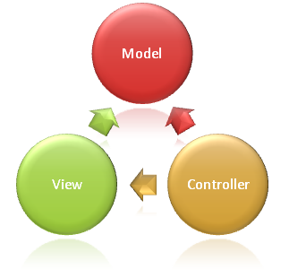
MVC Pattern
2WEB

Slide 5

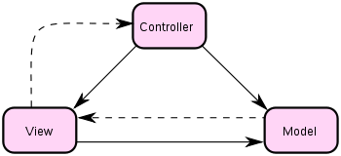
Introduction
MVC Pattern
Model
Retrieves values from data source (database, plain text, …)

Slide 6
Introduction
MVC Pattern
View
Represents the user interface (HTML page, …)
Called by the controller

Slide 7
Introduction
MVC Pattern
Controller
Processes and responds to events
May change model data

Slide 8

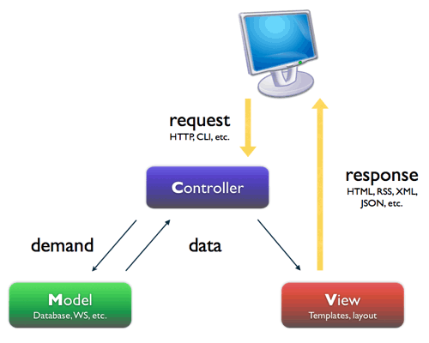
Request processing
MVC Pattern
A client request is handled as follows:
A client asks to view a page
Controller gets request
Fetches data from model
Processes logic layer
Passes data to the view
View integrates data
Returns page to client

Slide 9

Pros and cons
MVC Pattern
Advantages
Separation of concerns: improves reusability
Time saving for maintenance
Flexibility for collaborative development
Scalable
Drawbacks
Not interesting for small projects
Notes:
In computer science, separation of concerns (SoC) is the process of separating a computer program into distinct features that overlap in functionality as little as possible. A concern is any piece of interest or focus in a program. Typically, concerns are synonymous with features or behaviors.
http://en.wikipedia.org/wiki/Separation_of_concerns

Slide 10
MVC is just a pattern
MVC Pattern
Remember MVC is just a pattern:
It’s just a way to organize your code
Not a specific software/plugin to install
You can do your own!

Slide 11


Questions ?

Slide 12

Exercise – Controller & View
MVC Pattern
We’ll create a simple MVC pattern in PHP
Goal of this app:
A Controller can have several methods
Each method is linked to a view
Controllers and view are set with GET parameters
Notes:
Note that PHP will evaluate $getControllerParameter before doing the « new » statement. Therefore allowing to instanciate objects in a dynamic way:
$className = "PDO";
$pdo = new $className(...);
Same applies for methods. In this example, the $getViewParameter variable contains

Slide 13


Exercise – Controller & View
MVC Pattern
Example called URL:
http://localhost/mvc/?controller=home&view=default
Instanciates
Requires
HomeController
mvc
index.php
function home()
home
default.php
Calls
UserController
user
function profile()
profile.php
Notes:
Note that PHP will evaluate $getControllerParameter before doing the « new » statement. Therefore allowing to instanciate objects in a dynamic way:
$className = "PDO";
$pdo = new $className(...);
Same applies for methods. In this example, the $getViewParameter variable contains

Slide 14
Exercise – Controller & View
MVC Pattern
Example called URL:
http://localhost/mvc/?controller=user&view=profile
HomeController
mvc
index.php
Instanciates
function home()
Requires
home
default.php
UserController
user
function profile()
profile.php
Calls
Notes:
Note that PHP will evaluate $getControllerParameter before doing the « new » statement. Therefore allowing to instanciate objects in a dynamic way:
$className = "PDO";
$pdo = new $className(...);
Same applies for methods. In this example, the $getViewParameter variable contains

Slide 15
Exercise – Controller & View
MVC Pattern
Create a folder Controllers
Inside, a class HomeController
With two methods: default() and about()
Create a folder Views:
Inside, a folder : home
Inside the home folder, two PHP files with HTML in it:
default.php
about.php

Slide 16
Exercise – Controller & View
MVC Pattern
In your root index file:
Get the $_GET parameter « controller »
Get the $_GET parameter « view »
Instanciate a class depending on the controller param:
$controller = new $getControllerParameter();
$controller->$getViewParameter();
Notes:
Note that PHP will evaluate $getControllerParameter before doing the « new » statement. Therefore allowing to instanciate objects in a dynamic way:
$className = "PDO";
$pdo = new $className(...);
Same applies for methods. In this example, the $getViewParameter variable contains

Slide 17
Exercise – Controller & View
MVC Pattern
In your HomeController, in method index:
Define an array with two cells:
FirstName => « John »
LastName => « Doe »
Require the home/index.php file
$array = ...
require_once("...");

Slide 18
Exercise – Controller & View
MVC Pattern
In your HomeController, in method about:
Define an array with two cells:
Title => « About »
Description => Use lipsum.com to generate some paragraphs
Require the home/about.php file
$array = ...
require_once("...");

Slide 19
Exercise – Controller & View
MVC Pattern
Access your website
Check that it works!
Style your pages

Slide 20
Database
MVC Pattern

Slide 21
Nothing changes
Database
Controllers have access to database
Pass data to views
No access from view to model!
You can create a Database class
Will instanciate PDO
Do requests

Slide 22
Exercise – MVC
MVC Pattern
Create a folder Models
Inside, a class User
With three properties:
Id
FirstName
LastName
With two methods:
getFullName: Returns concat of FirstName and LastName
sayHello: Returns « {fullName} says Hello! »

Slide 23
Exercise – MVC
MVC Pattern
Create an abstract class Database
On construct, instanciate PDO
Store the PDO instance in a private property
Create a class UserDao
Extends Database
One method: get($id)
Will issue a database request to get an user based on its id
Use PDO FETCH_CLASS mode to return an User instance

Slide 24
Exercise – MVC
MVC Pattern
Create an UserController (in Controllers folder)
With one method: profile()
Should retrieve the id passed as GET parameter
Should call UserDao to get the user
Pass the User to the view
Create a view profile.php (in Views/user folder)
Display each property and call each method in your view

Slide 25
Exercise – MVC – Bonus
MVC Pattern
Users, Posts & Comments:
Use this structure in the previous PDO exercise
Gather posts and users as seen before
Create views
Check that everything works!
The layout file:
Refactor your views to require a header & footer file
Will contain shared HTML code in every view

Slide 26

The end
MVC Pattern
Thanks for your attention

